Slide 1
A Year’s Growth: Differentiation for Gifted Students in Math
Amber Trantham, NBCT
AMSTI Math Specialist
Notes:
THAT STUDENTS DIFFER MAY
BE INCONVENIENT, BUT IT IS
INESCAPABLE. ADAPTING TO THE
DIVERSITY IS THE INEVITABLE
PRICE OF PRODUCTIVITY, HIGH
STANDARDS, AND FAIRNESS
TO THE STUDENTS.
Horace’s Compromise (Sizer, 1984)

Slide 2
Common Ways Teachers “Occupied” students who had already mastered the content:
Assistant teacher/tutorer
Technology
Additional work or assignments
Read a book
Notes:
In the past, our gifted students have been neglected

Slide 3
Enrichment is NOT teaching the next grade level’s content.
-Jason Zimba
Notes:
Promote
Leadership
Creativity
Social Justice
Problem Solving
Critical Thinking

Slide 4
WE ARE NOT ALL THE SAME;
WE DO NOT ALL HAVE THE SAME
KINDS OF MINDS; EDUCATION
WORKS MOST EFFECTIVELY FOR
MOST INDIVIDUALS IF THESE
DIFFERENCES … ARE TAKEN INTO
ACCOUNT RATHER THAN
DENIED OR IGNORED.
“Reflections on Multiple Intelligences”
(Gardner, 1995)

Slide 5
This is an opportunity to connect with the student and with their family.
Design enrichment collaboratively
The student should feel empowered, supported, and responsible.
Guidelines should be created and any activity or assignment should have purpose and a timeline.
A contract can outline all parties rolls and responsibilities.
Notes:
Enrichment should not be a punishment and should take into consideration the students interests, abilities, and passions. What do they love? What are they curious about.

Slide 6
Beta Testers
Websites
Activities
Games
Notes:
Provide students with the topics to be studied in the upcoming weeks and online activities to support learning on those topics. Ask students to beta-test the activities and websites and provide feedback to you as to which activities and sites are the most engaging, easiest to use, most valuable in terms of learning, with the fewest technical issues. Have them create or complete a rubric to evaluate the sites with.

Slide 7
Graphic Design
Digital Anchor Charts
Models and Representations
Adertisments

Slide 8
Developing Test Items
Learning how to create distracters
Rewriting test items to be applicable to students

Slide 9
Real-life Application or Career Research
When will I ever use this in real life?
Story problems exemplifying how the skill is applied in students’ lives

Slide 10
Data Collection
Lowest price vendor for t-shirts, fundraisers or transportation on field trips
Class or school-wide polls

Slide 11
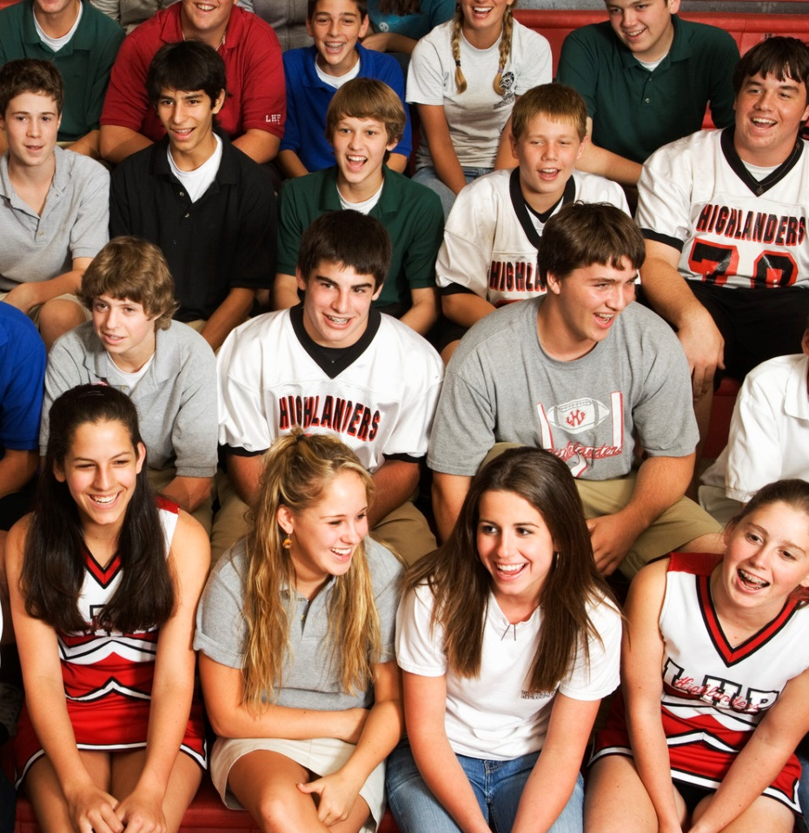
Grant Writing
Who knows the needs of the school and classroom better than those who are in it day after day?
Notes:
Have students identify an academic/extraculricular need

Slide 12
Planning and Organizing Field Trips

Slide 13
Creating and Maintaining Classroom webpages, social media, or BLOGS
Edmodo
Learn Zillion
Blogger
Wiki

Slide 14
Digital Yearbook or Digital Portfolio of Math Learning
Scanning work samples
Digital layouts
Photography and video

Slide 15
Resources
PBL Sites and Information http://edtecher.hubpages.com/hub/math-project-ideas-examples
Teaching Mathematics to Gifted Students in a Mixed-Ability Classroom http://www.gifted.uconn.edu/siegle/tag/Digests/e594.html
Gardner, H. (1995). Reflections on multiple intelligences: Myths and
messages. Phi Delta Kappan, 77(3), 200-203, 206-209.

